Slide 1

HOME Best Practices
2023 Annual Conference
June 13, 2023

Slide 2


Slide 3

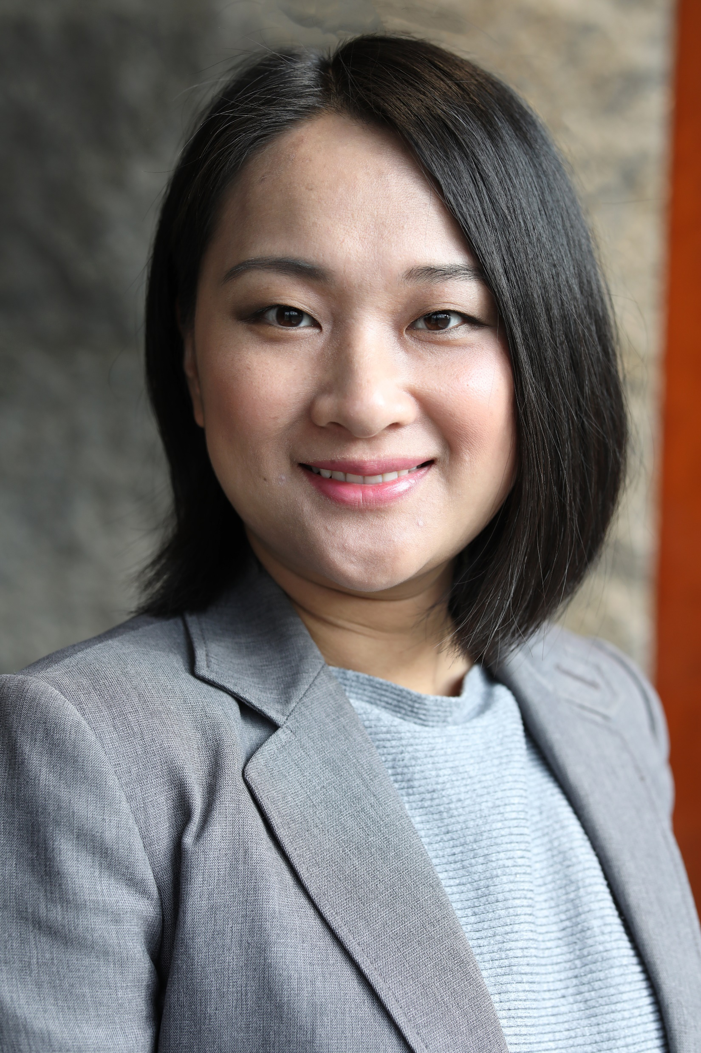

MODERATOR
Sharon Burkley
Community Development Planning Manager
City of Fort Worth, Texas
20+ years working with HUD Grants (CDBG/HOME/ESG/HOPWA)
SPEAKER
Susan Zou
Housing Programs Manager
City of Quincy, Massachusetts
10+ years working with HUD Grants (CDBG/HOME/Lead/Healthy Homes/AHTF)
SPEAKER
Eric Keeler
Deputy Director, Office of Housing
City of Alexandria, VA
28+ years working with HUD Grants (CDBG/HOME)

Slide 4

GENERAL HOUSEKEEPING
Silence cell phones
Limit conversations
Questions will be taken after each presentation
Participation is encouraged

Slide 5





HOME Best Practices
South Shore HOME
Consortium
City of Quincy
Town of Weymouth
Town of Braintree
Town of Holbrook
Town of Milton
Sherry Zou, Housing Programs Manager City of Quincy, Massachusetts

Slide 6
Office of Healthy Homes
Overview
Personnel: Staff of 4 (in-house); 4 Consultants
HOME Consortium Lead Representative Member
Administers 5 Programs with 5 Funding Sources*
  Housing Rehab, Lead Abatement, 1st-Time Homebuyer, rental Development, TBRA
  CDBG, HOME, Lead/Healthy Homes, AHTF
  *Housing Choice, MAPC TAP
  *Partners Funding: State Lead Paint Grant, Home Modification Grant, MassSave, Non-profit Emergency Repairs, Community Action Program Weatherization

Slide 7
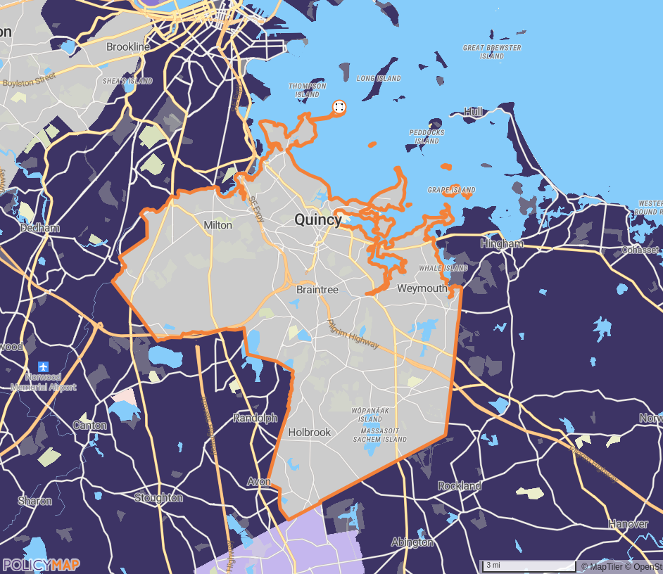
HOME Consortium
Overview
South Shore HOME Consortium
  Quincy, Weymouth, Braintree, Milton, Holbrook
  Entitlement: <$1M
  Activities: Rental, Homebuyer, Homeowner Rehab, TBRA
Population | Households | Median Income | HOME Limit*
223,665 | 89,275 | $80,174 | $118,450
*2023 HOME Income Limit 4-Person 80% AMI

Slide 8
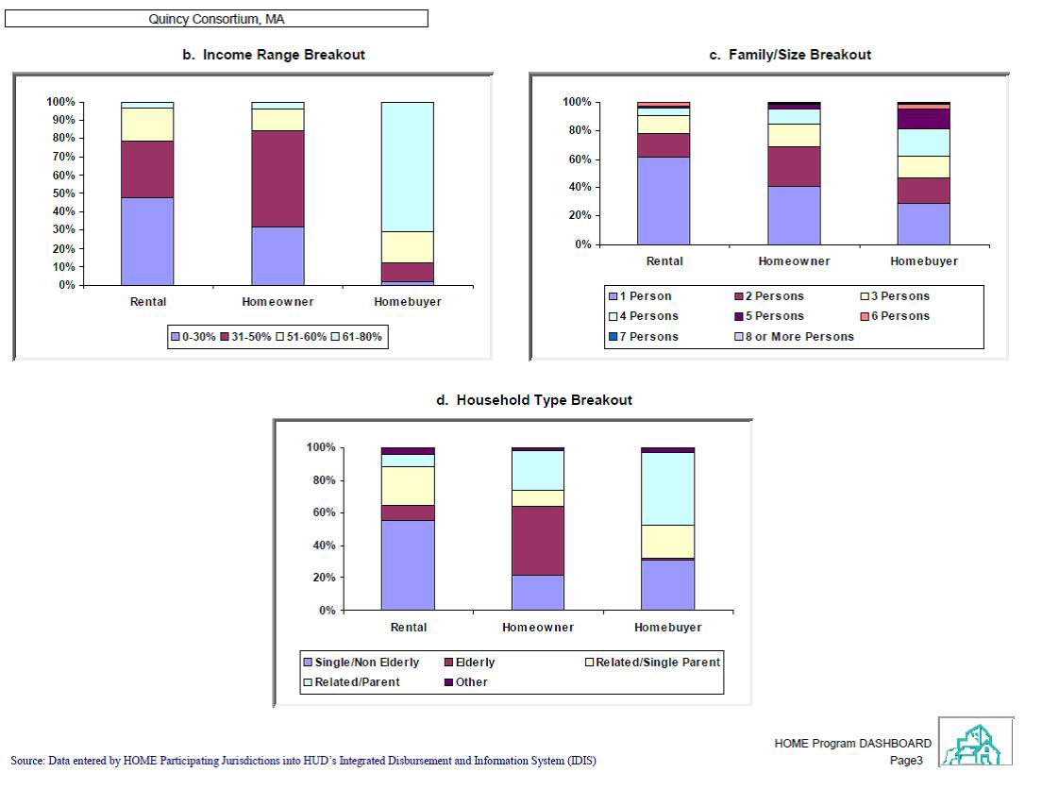
Demographics
Median Rent $2,300
Average Home Value $480k – 925k
60% Homeowners, 40% Renters
FMR 2-BR $2,635
Low/High HOME Rent $1,670 / $2,143

Slide 9
Key Elements
Partnerships, CHDOs
Project Selection and Underwriting
Processes
Financial Management
Monitoring, Compliance, and Reporting

Slide 10
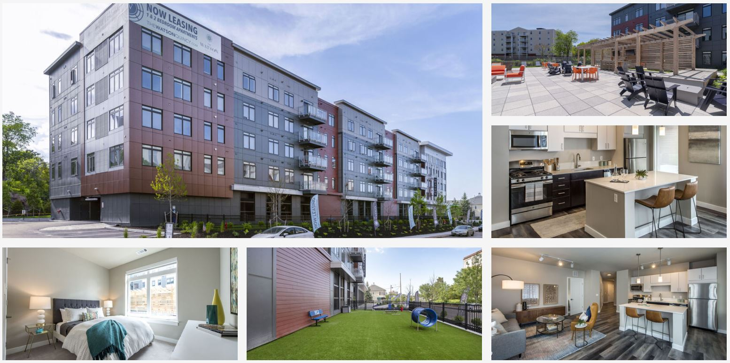
Project: The Watson,
Quincy
(Approved 2016, Completed 2019)
HOME | State | Private | LIHTC
$500,000 | $9.4M | $32.2M | $2.3M
1.1% | 21% | 73% | 5.2%
Total project cost $44.4M
140-unit mixed-income rental (86 workforce units up to 110% AMI; 28 units below 50% of AMI; 26 units market rates)
Received The Urban Land Institute’s Jack Kemp Excellence in Affordable and Workforce Housing Award

Slide 11
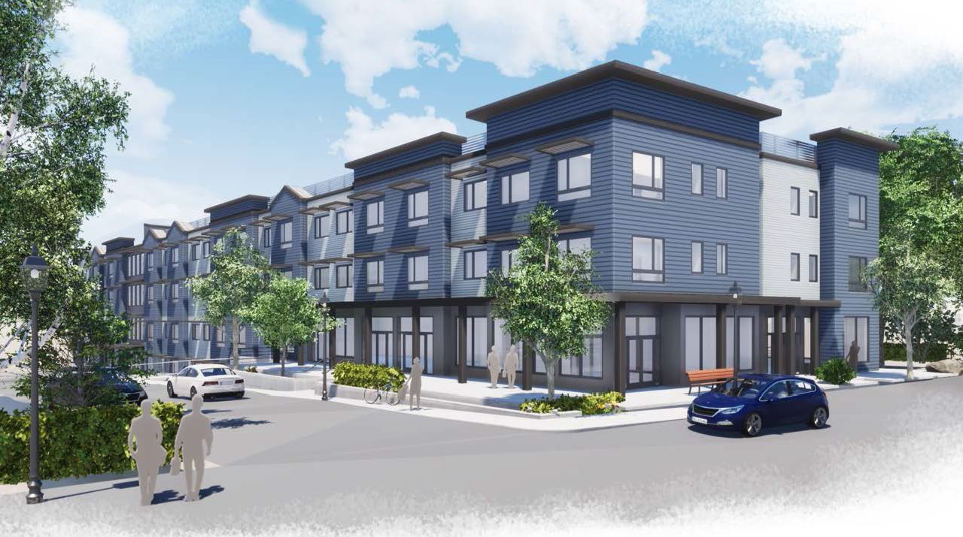
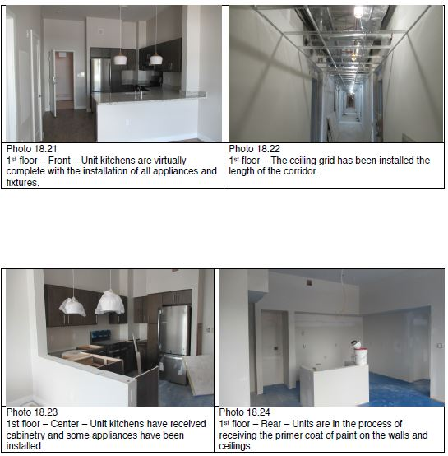
Project: Holbrook Centre Senior Housing
(Approved 2019, Occupancy expected September 2023)
HOME | State | Private | LIHTC
$1.35M | $6M | $5.6M | $16M
4.7% | 21% | 19.3% | 55.2%
Total project cost $29M
72-units
18 units 30% AMI; 54 Units 60% AMI

Slide 12
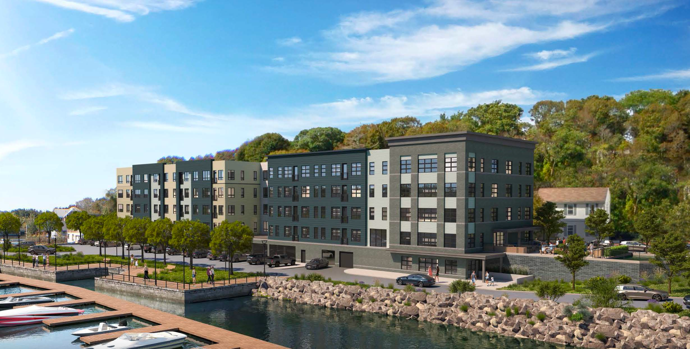
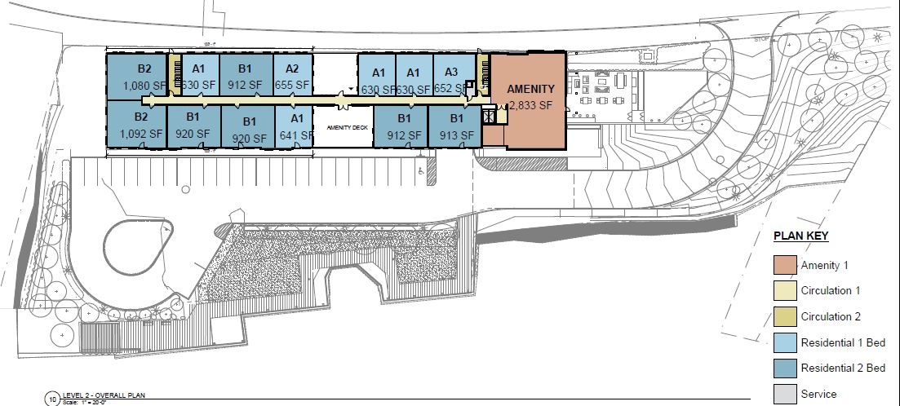
Project: Watson Place,
Braintree
(Application approved 2023)
HOME | State | Private | LIHTC
$1.3M | $8M | $11.7M | $21M
3% | 19% | 28% | 50%
Total project cost $42M
56-unit mixed-income rental (8 PBV units below 30%, 14 units between 30-60%, 6 units between 60-80%, 20 Workforce units between 80-120% AMI, 8 units market rates

Slide 13
Tips
Trainings, TA
HUD Checklists
IDIS Reports (PR16, 20, 25, 27)

Slide 15
Questions?

Slide 16
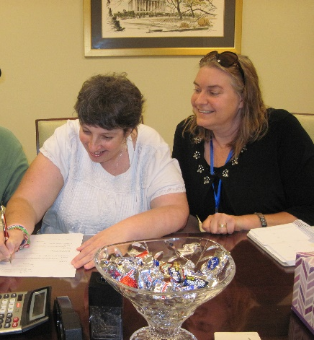
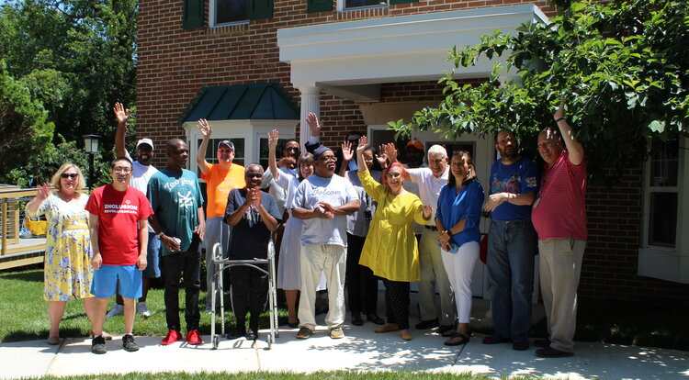
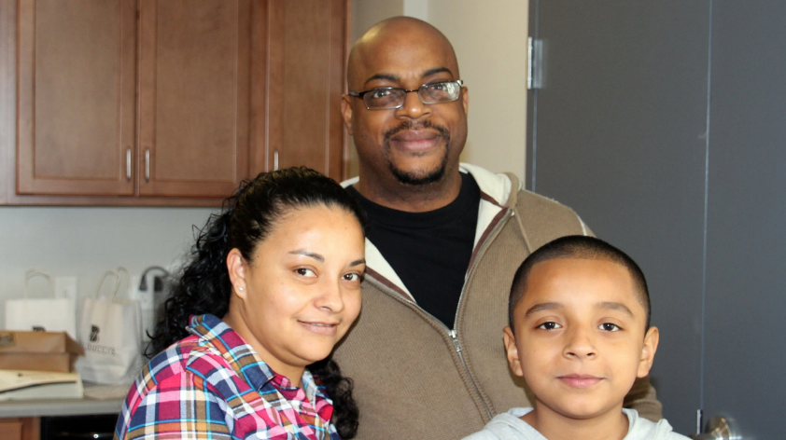
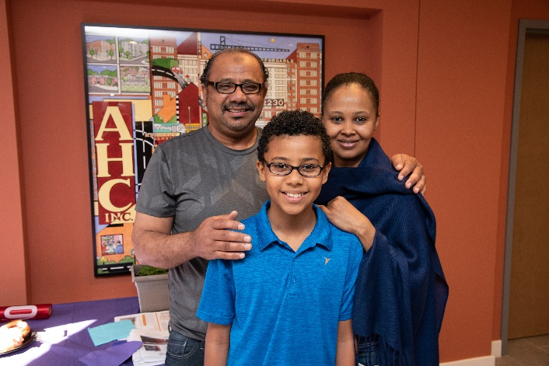
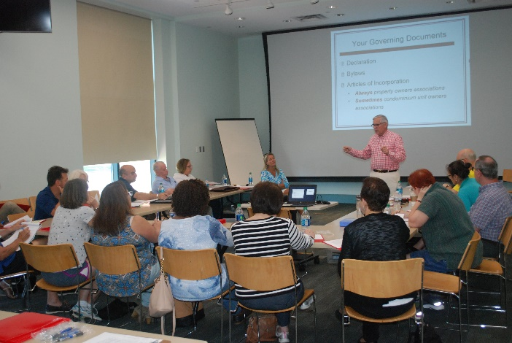
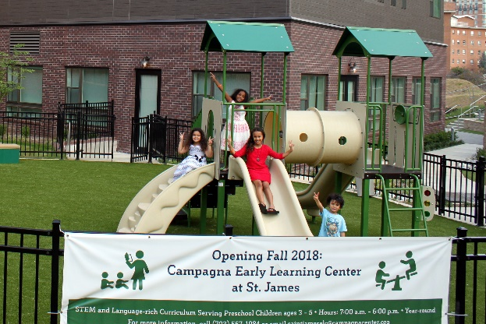
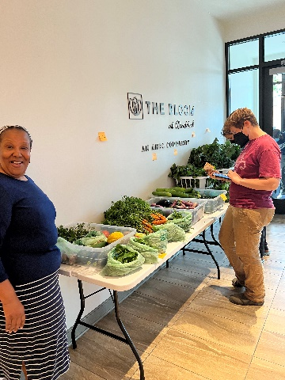
NCDA Annual Conference 2023
HOME PROGRAM
City of Alexandria, VA
Eric Keeler, Deputy Director, Office of Housing
https://www.alexandriava.gov/Housing

Slide 17









Office of Housing
17-member strong
Provides landlord-tenant services (complaint resolution, mediation, and relocation assistance) and eviction prevention
Develops affordable housing policy
Conducts fair housing testing and training
Provides loans and technical assistance to partners
Provides home purchase assistance and training, foreclosure prevention, and condo governance education
Runs home rehabilitation loan program, and manages rental accessibility grants
Works to secure affordable units through development

Slide 18


$940,375
AVERAGE SINGLE-FAMILY ASSESSED VALUE
WHO CAN AFFORD TO OWN IN THE CITY?
$407,616
AVERAGE CONDOMINIUM ASSESSED VALUE
+ CONDOMINIUM FEES
Source: Office of Real Estate Assessment, February 2023

Slide 19

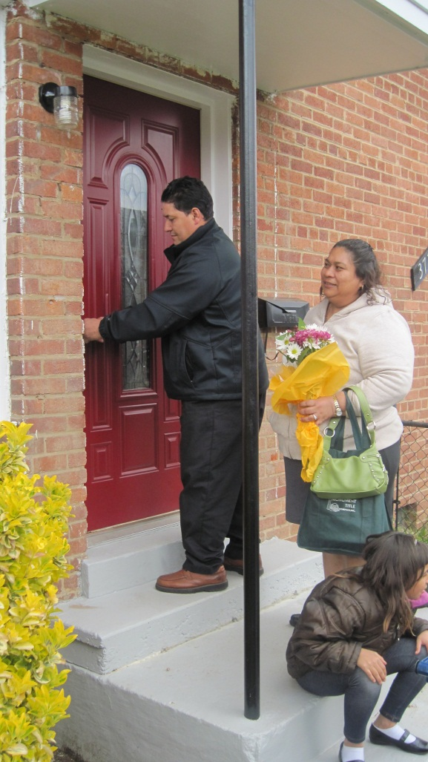
City of Alexandria Homeownership Resources
Can provide assistance towards the purchase of:
  Affordable Set-aside Units
  Resale Restricted Homeownership Units
  Employee Homeownership Incentive Program (EHIP)
Programs are funded through a revolving loan funds
  Current Asset Balance Sheet $20m
  Annual Repayment income $500-600,000
https://www.alexandriava.gov/housing-services/homebuyer-resources

Slide 20
Flexible Homeownership Assistance Program (FHAP)
Provides a second trust loan of up to $50,000 in deferred payment, equity share, 0% interest financing.
Currently based on interest rate hikes up to $75,000
HOME Income limits up to 80% of area median income ($113,840 for a family of 4)
Currently based on limited resources assistance may only be used to buy properties that Office of Housing markets for sale

Slide 21
FHAP Basic Eligibility Guidelines
Must be a first-time homebuyer
Must live or work within the City of Alexandria
Have a gross annual income within current limits
Complete required homebuyer training and a counseling session
Federal assistance limits
 | Tier 1 (HUD 80%) provides up to $50,000 in assistance | Tier 2 (Mathematical 80%) provides up to $40,000 in assistance
1 person 2 person 3 person 4 person 5 person 6 person | $63,000 $72,000 $81,000 $90,000 $97,200 $104,400 | $63,001 - $79,760 $72,001 - $91,120 $81,001 - 102,480 $90,001 - $113,840 $97,201 - $122,960 $104,401 - $132,080

Slide 22
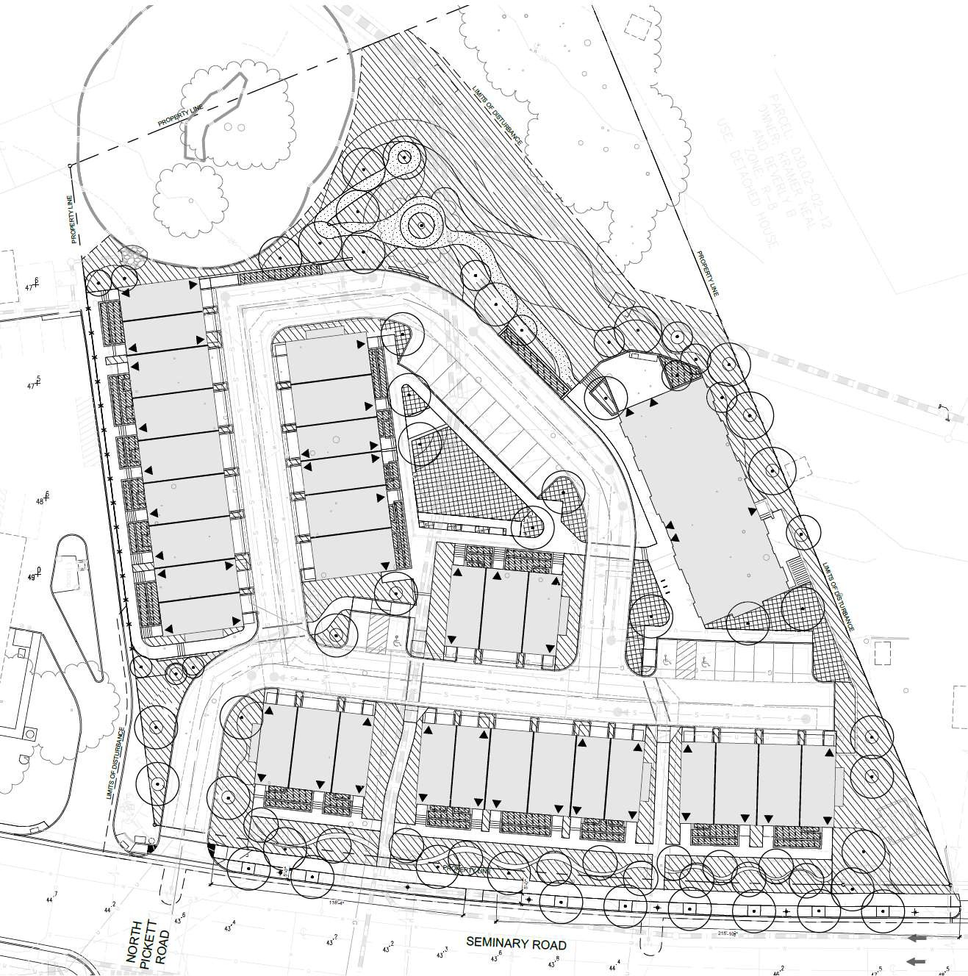
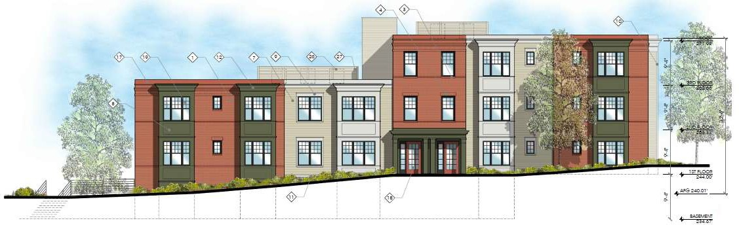
Housing Alexandria SEMINARY ROAD PROJECT
Condominium Townhomes
  31 units
  2 and 3 bedrooms
  3 levels with garage on bottom floor
Condominium Flats
  5 ownership units (2 bedrooms)
  3 Sheltered Homes of Alexandria units
  (4 bedrooms)
  3 stories with elevator
Targeting Households at 80% AMI and below
$300k-$400k sales price
HOME Funds for development (CHDO)

Slide 23
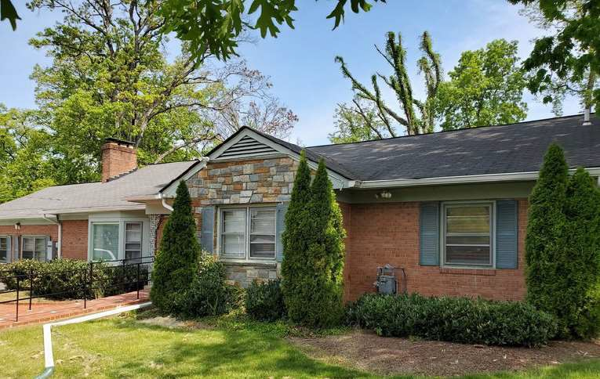
RELOCATION PLAN
Existing Residents at 4547 Seminary Road
  SHA owned group home
    6 residents
    4 Bedroom 3.5 Bath
Temporary Relocation During Construction
  Tenants will continue to receive services through DCHS
  Costs of two moves will be covered
  Tenants to return post- construction
Resident Communication
  All communication through tenant guardians
  Introductory meeting held in 2020
  DCHS to meet with guardians Winter 2021
  120 day notice to vacate, 30 day notice of temporary relocation address

Slide 24
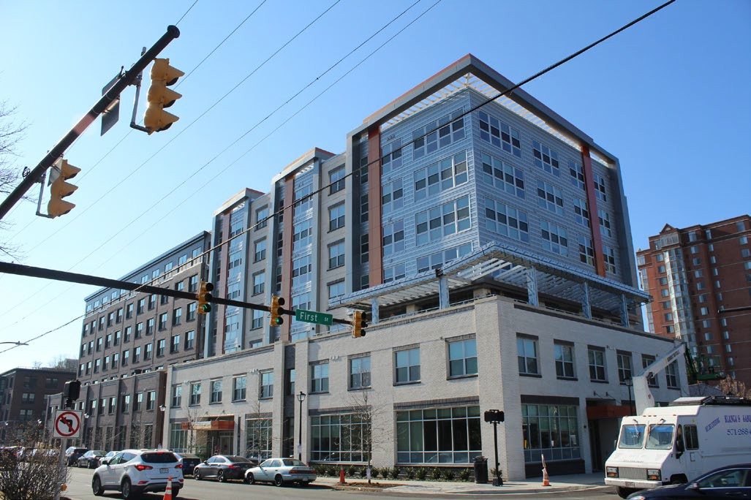
THE BLOOM & CARPENTER’S SHELTER AHDC
Opened in 2020
97 apartments affordable at 30%-60% AMI
Including 10 permanent supportive units (services provided by shelter staff)
FINANCIAL PROFILE:
The Carpenters Shelter-
18,000 Sq Feet
•
Community Meeting Space
Production Garden
Playground
$22.6M
$10.3M
$1.5M
$1.6M
$9.9M
Tax Credit (LIHTC) Equity Private Debt
Developer Investment (fee) Fed/State Housing Trust Fund
City Gap Loan
City Housing Trust Fund
Eight HOME Units - CHDO
60 bed shelter
Day program space
Office Space
Service & Meeting Space
Outdoor Community Space
FINANCIAL PROFILE FOR THE CARPENTER SHELTER:
$2M - Funding raised
$M Land Payment
TOOLS:
ZONING—Bonus density
PARTNERSHIP- City, AHDC and
Carpenter Shelter working together to build a new shelter plus an affordable housing building
Federal HOME - $500,000
General obligation bonds Dedicated tax revenue Meals tax revenue
+ $350k City grant for rental assistance subsidy for five years for 10 units from City HTF
MULTILAYER FINANCING- Federal
Housing Trust Fund (HTF), State HTF, City HTF, Virginia Housing LIHTC and debt financing, HOME Funds, City Funds
5

Slide 25
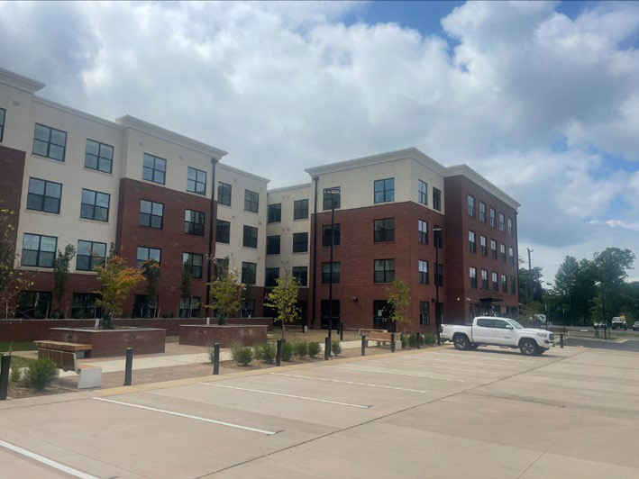
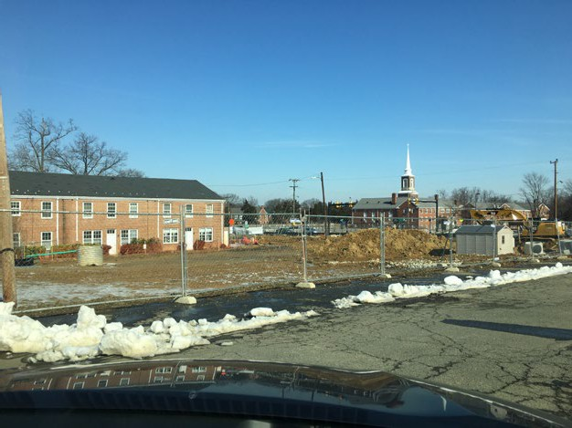
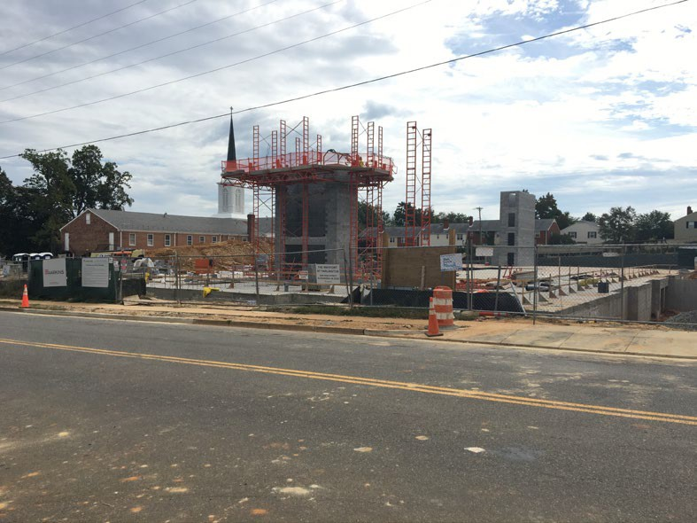
Waypoint at Fairlington
Wesley Housing
Opened in 2022
81 apartments affordable for 40 years at 40%-60% AMI
▪
Eight HOME Units
FINANCIAL PROFILE:
$18.1M— LIHTC Equity
$10.5M— Private Debt
$700K -- State Housing Trust Fund
$250K -- Other
$7.7M—City Gap Loan
Housing Trust Fund
TOOLS
SITE: Development on a church parking lot
PARTNERSHIPS: With the Church to provide capital improvements and shared Play Space
▪
Federal HOME - $500,000
Dedicated tax revenue
Meals tax revenue
6

Slide 26


Questions?
Sharon Burkley | Sharon.Burkley@fortworthtexas.gov | 817-392-5785
Sherry Zou | szou@quincyma.gov | 617-745-7168
Eric Keeler | eric.keeler@alexandriava.gov | 703-746-3085

